Slide 1
Building Quality Health Academies

Slide 2
Presenters
Dr. Kevin Elling: (retired doctor of chiropractic) Lead Teacher PAHS
Ms. Pam Avila NP: (retired nurse practitioner) CTE teacher
Dr. Myron Lord: (retired ObGyn) Chairman PAHS Advisory Board
Round Table Discussion
Jeanni Buzzelli – Dean, Lead Counselor PHS
Salma Aziz – Assistant Principal PHS
Karen Fleming (retired RN) CTE teacher
Ashlee Starks – Math teacher PAHS

Slide 3
About PAHS
Been a CPA for …years.
NAF certified academy for 2 years.
NAF editors and pilots
Connect Ed/Linked Learning
Strong CTE component
Incoming freshman class of over 100 for past three years.

Slide 4
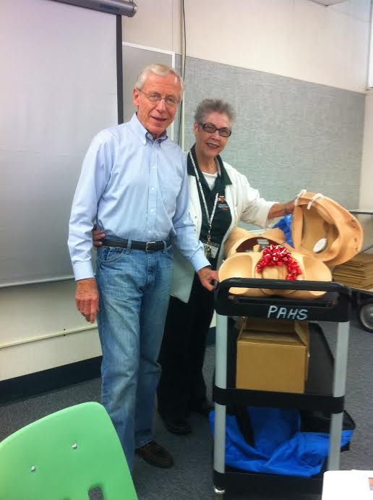
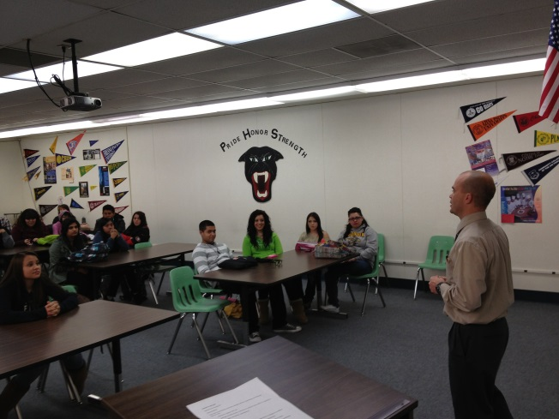
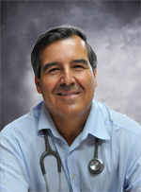
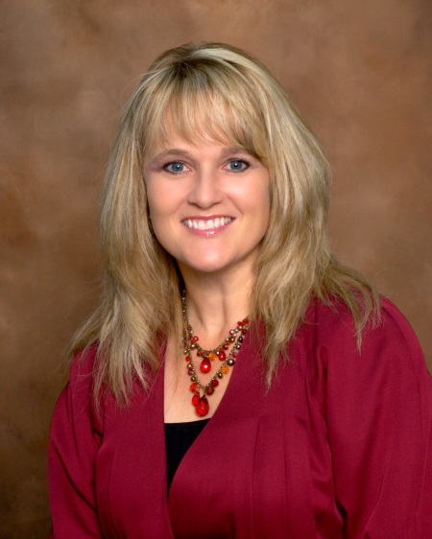
Advisory Board
Dr. Lord – chairman
Dr. Suorsa (optometrist)
Dr. Ramon Resa (pediatrician)
Ms. Donna Hefner (CEO Sierra View Hospital)
Dietician, MDs, and people with backgrounds in emergency medicine.

Slide 5
Building a Strong Board
Everyone sees doctors – ask around
Think outside the box (allied, alternative health, emergency services)
Give them a brochure with contact information
Get their contact information
Board meets 70 minutes once a month
It’s prestigious to be on the board

Slide 6
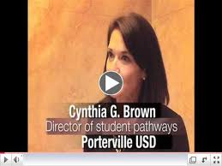
Industry Partners/Internships
Advisory Board members
Member’s friends/colleagues
Pathway teacher’s providers.
Hospitals
Skilled Care Facilities
Mental Health
Urgent Care
Ask District to help

Slide 7
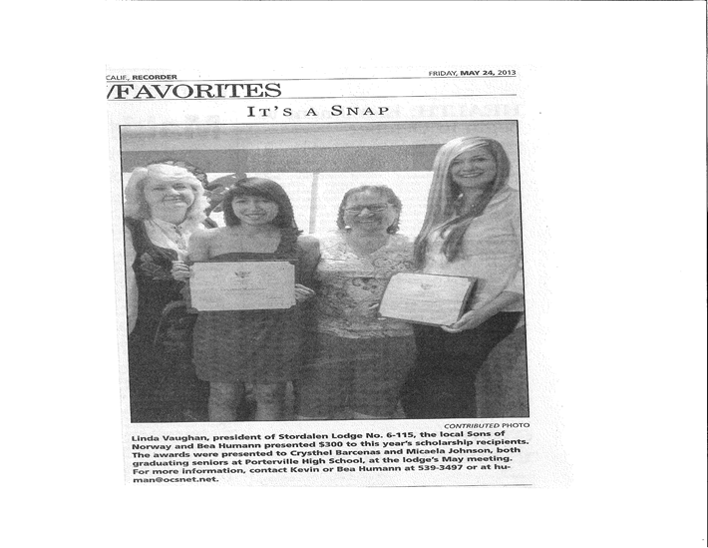
Scholarships
Advisory Board members and their friends/colleagues
Hospitals
Skilled Care
Large HMOs (Kaiser)
Retired doctors
Businesses

Slide 8
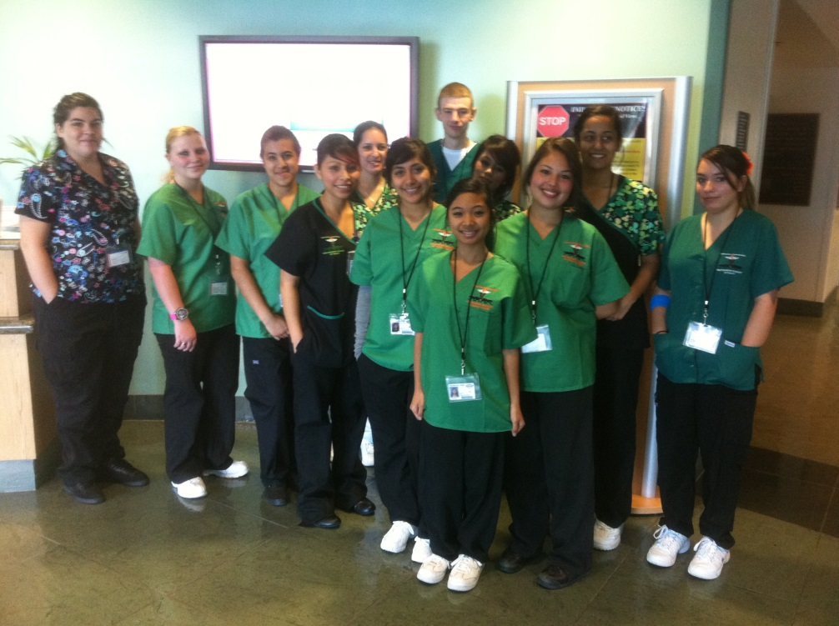
Compensation while in School
Freshmen – First Aid/CPR
Sophomores (16+)- Certified Nursing Assistant
Juniors – Medical Assisting
Seniors – EMT 1

Slide 9
Quality CTE and Core Teachers
CTE – retired or injured professionals
Look around the district
Ask around town
Put the word out
Principal isn’t the only recruiter!

Slide 10
Quality Curriculum
Tweak the classes according to need
Common Preps for teachers
Bi-monthly meetings
Board input
Industry needs
Passionate teachers

Slide 11
Roundtable Questions
Sequencing, Student Contracts, Student Recruitment, Integrated Projects, Scholarships, Mentorships, and/or Other?

